Slide 1
Efficient forecasting and uncertainty quantification for large scale account level Monte Carlo models of debt recovery
Abhishek Thomas

Slide 2
INDEX
Challenges & solution
Results
Methods and approach
Representative model
Error analysis and optimal number of realisations
Uncertainty quantification
Protection of portfolio-level forecasts
Predicting the variance of independent accounts using Gaussian process emulators

Slide 3
Challenges & Solutions

Slide 4
Challenge
Have to predict probability of payment for each account for each month in next 7 years (84 points)
Have to use individual level forecast which is aggregated to make population level forecast on a biannual basis called forecasting rounds
Need to use monte Carlo simulation because there are lot of random factors
Using monte Carlo is expensive because there are millions of heterogenous accounts, even though model is simple logistic regression to find the probability of payment
Since there are so many accounts its outcomes are limited and the simulation will be too expensive to carry for all accounts, we don’t know how to use the limited amount of outcomes and if we are using it with how much certainty can we say
Solution
Creating an efficient monte carlo simulation to give only required outcomes or predictions by reducing variance
Uncertainty interval in the aggregated forecast
To implement the above 2 things we make gaussian process emulator for prediction interval and efficient carlo outcomes

Slide 5
Results

Slide 6
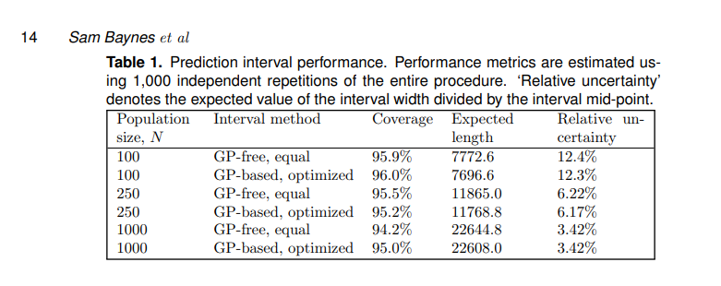
The paper showed that significant reductions in forecast uncertainty and improvements in computational efficiency could be achieved using their proposed techniques.
Efficient Allocation of Computational Resources:
- This optimal allocation method, combined with pre-estimating the account-level variances using Gaussian process emulators, reduced the variance of the estimator for the expected total collections by 33% compared to equal allocation of realizations across accounts.
Uncertainty Quantification:
- Through simulation studies, they showed that these prediction intervals had coverage probabilities close to the nominal level (e.g., 95% for a 95% prediction interval), even for relatively small population sizes.
Protection of Portfolio-Level Forecasts:
- The authors proposed a methodology to constrain the optimization problem such that the variances of the forecasts for important sub-portfolios are kept below specified thresholds.
- By redistributing computational effort to the accounts in the constrained sub-portfolios, the variances of the sub-portfolio forecasts could be reduced to meet the desired thresholds.

Slide 7
Representative model

Slide 8
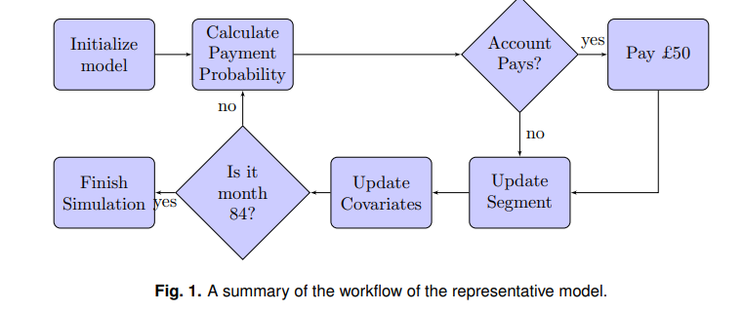
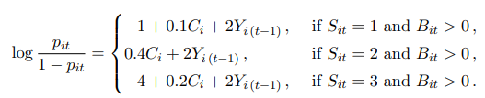

Population
Accounts has accumulated over more than a decade and is composed of a wide variety of products, from loans, overdrafts, and credit cards to mail order credit, telecommunication debt, and student loans. As such the portfolio is highly heterogeneous, and the model is complex.
Representative model used to simplify the AGL model and shares the main characteristics of AGL’s model.
Model Parameters
Uses logistic regression time series to give output Pit which is probability of payment for next month using inputs of previous month. The inputs are
Xit(collection amount), the amount paid by the customer
Yit(Payment indicator), 1 or 0
Zit(Covariates(Bit, Cit, Sit, Eit))
Bit, balance amount
Cit, credit score
Sit, operational segment
Eit, eligibility indicator
Where
i ranges from 1 to N,
t ranges from 1 to 12*7= 84 months

Slide 9
Methodology
the covariate values for N accounts are initialized via simulation from appropriate distributions to give heterogeneous behaviour similar to that observed in AGL’s commerical model
Si1 can be put into 1(20%), 2(20%) or 3(60%) segement . Where
1, mostly likely to pay
2, can pay
3, very difficult to pay amount
Segment transition
Accounts can transition between if the meet the criterias
the account is eligible for transition;
the account is in Segment 3;
the account did not make a payment in the preceding month.
Eit Eligibility is decided according to a time-independent indicator covariate Ei which is initialized according to Ei ∼ Bernoulli(0.1).
Segment transition is also dependent on other payment pattern of other accounts
Macroeconomic is also a factor commonly, but not in scope of this paper

Slide 10


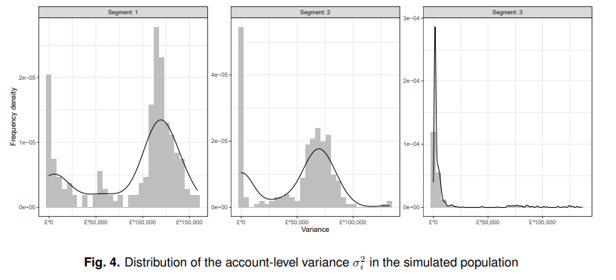
Estimation of expected collection
Difference between representative and commercial model
Aspect | Paper's Model | Arrow's Commercial Model
Model Complexity | Simplified for clarity and explanation | More complex and tailored to real-world needs
Data Inputs | Basic data like credit score, payment history, balance | Detailed data, including demographics and external credit reports
Segments and Transitions | Simple segment rules with predefined probabilities | Sophisticated segments and dynamic rules
Payment Probability | Logistic regression | Advanced machine learning techniques
Payment Amount | Assumes fixed or simple proportional payments | Detailed rules for determining payment amounts
Simulation Efficiency | Focuses on improving computational efficiency | Efficient but uses proprietary methods
Uncertainty Quantification | Develops prediction intervals to measure uncertainty | Uses additional methods like scenario analysis
Integration with Operations | Demonstrates theoretical concepts | Fully integrated into day-to-day operations
Data Granularity | Uses monthly data and biannual updates | More frequent updates (e.g., weekly or daily)
We can get average by summing collection amount and the R (no of probability of payments) all accounts
We can see expected collection distribution of various the segments below

Slide 11
Error analysis and optimal number of realisations

Slide 12
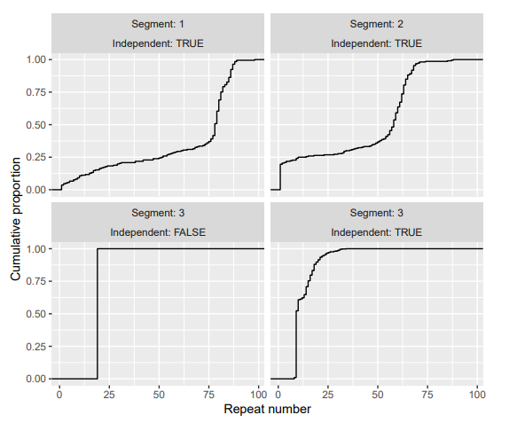
The accounts which need to be selected should be having high variance as they contribute more
Equal no of accounts with high variance in covariates should be picked from each segment for the monte carlo simulation
Doubt in the final graphs( independent and dependent realisation in segment 3 , and no of realisation is 1 and 2 )
All this is done on the pilot forecast
This optimal allocation method, combined with pre-estimating the account-level variances using Gaussian process emulators, reduced the variance of the estimator for the expected total collections by 33% compared to equal allocation of realizations across accounts.

Slide 13
Uncertainty quantification

Slide 14
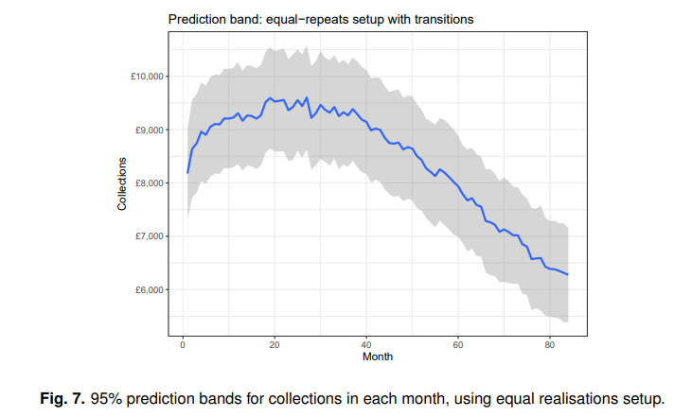
The point estimate of the expected collections does not give a complete picture, since the collections vary between realisations.
Need to find an interval of how much it can vary from the mean
It is clear that there is substantial uncertainty which is roughly constant over time, but the width of the interval is of a smaller order of magnitude than the expected collections. For the optimized realisations setup the prediction band could not be computed as some accounts have Ri < 2, precluding the use of the sample variance to estimate σ 2 it = Var(Xit), needed in the standard error. It is not possible to estimate σ 2 it via Gaussian processes without fitting GP models in each different time period, which is costly and excessively complex
Asymptotic results
Condition (R5a) corresponds to an assumption that the variance of the dependent block is asymptotically of smaller magnitude than that of the independent block. This can be avoided by assuming approximate normality of the contribution from the dependent accounts, and a large number of simulated realisations of the dependent block
Coverage study
The results show that the coverage, i.e. the probability that the prediction interval contains the true realised collections, is close to the nominal level of 95% even for quite small population sizes such as N = 100, and so the asymptotic results appear highly robust in practical situations.
The fact that the central limit asymptotics are highly accurate even for small population sizes is surprising.One potential explanation is that perhaps, owing to the large number of time points involved, the total collections at the level of a typical individual account level may themselves be close to normally distributed (cf. the Markov chain central limit theorem (16)).

Slide 15
Protection of portfolio-level forecasts

Slide 16
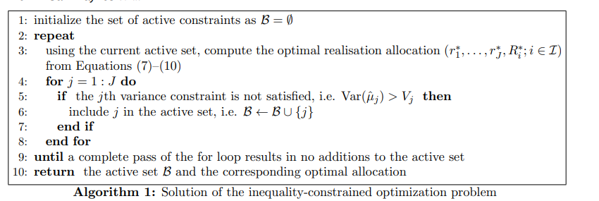
To illustrate the effect of this methodology we consider a setup with a population of N = 1000 accounts divided into two portfolios. The portfolios were defined by sampling an indicator with a 99% probability of belonging to Portfolio 1 and a 1% probability of belonging to Portfolio 2, independent of other accounts and the other variables. If no portfolio-level variance protection is applied then optimization of the realisation numbers yields a variances of 868.1 2 and 119.3 2 for the total collections in Portfolios 1 and 2, with Portfolio 2 having ten times greater variation relative to the expected collections. Applying portfolio protection with (V1, V2) = (10002 , 502 ) leads to a realisation distribution where much more computational effort is applied to accounts in Portfolio 2, in particular with an average realisation number of 84.8 compared to 29.2 for Portfolio 1. The effect of this redistribution of effort is to change the portfolio-level variances from (868.1 2 , 119.3 2 ) to (899.6 2 , 48.752 ), which meets the variance constraint. On other runs of the same code there was a slight gap in achieving the constraint due to errors in the estimates of σ 2 D,j and σ 2 i , but the variance in Portfolio 2 was always improved compared to the previous approach.

Slide 17
Predicting the variance of independent accounts using Gaussian process emulators

Slide 18
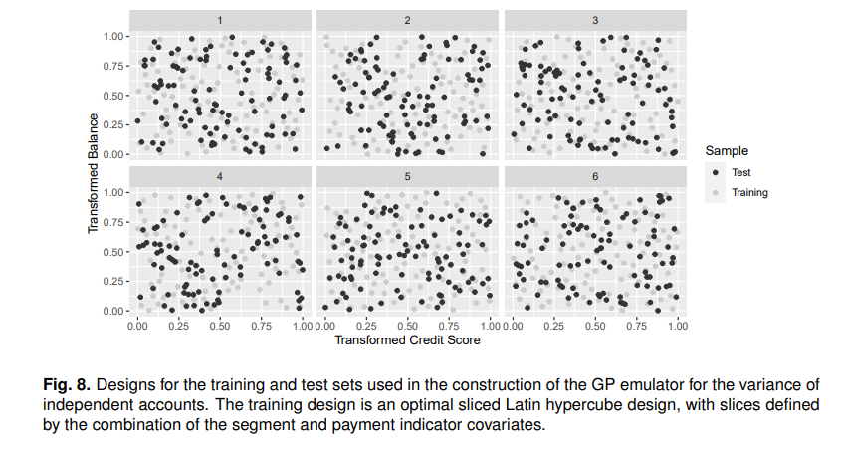
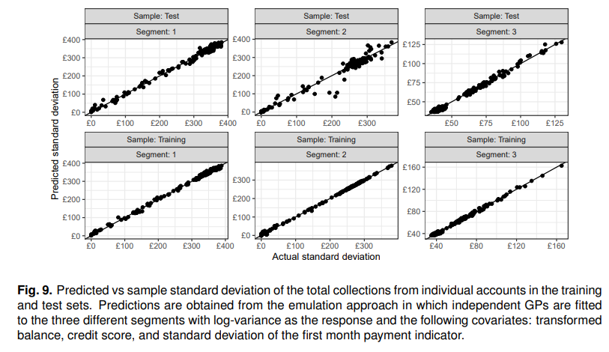
There are many possible approaches for fitting a Gaussian process emulator to these data. One of the most natural is to fit independent processes in each slice, using the log-variance as the response to ensure positive predictions for the variance. Specifically, let ˜vsy( ˜b, c˜) denote the logvariance function in the (s, y)-slice, and place a GP prior on this function with unknown constant mean and Mat´ern-5/2 covariance function. Due to asymptotics we may assume that log ˆvsyl ∼ N[˜vsy( ˜bsyl, c˜syl),(κsyl−1)/1000] approximately. Hence we effectively have noisy normal observations of the function ˜vsy, whose noise variance can be estimated by plugging in the sample kurtosis. Hence the posterior process can reasonably be approximated by a GP with mean and variance given by standard Kriging equations. Note that any data points with a sample variance of exactly zero must be excluded from the training set for this approach to work. We used the R package DiceKriging (13) to perform the actual numerical fitting
Although the above emulation approach is appealing in its simplicity, we found that its predictions were outperformed by another emulation method. Specifically in this second method, we fit an independent process to each of the three segments (rather than the six slices) with covariates given by the transformed balance, credit score, and also p p1(1 − p1) where p1 denotes the probability of payment in the first quarter. The latter corresponds to the standard deviation of the payment indicator in the first month. Again the model is constructed on the log-variance scale with the normal approximation log ˆvsyl ∼ N[log vsyl,(κsyl − 1)/1000] and noise variance estimated using the sample kurtosis. Figure 9 shows that this alternative method gives effective predictions on the test set. Though a small number in Segment 2 have their variance underpredicted, we believe that the overall quality of the predictions is adequate at the population level for the purposes of uncertainty quantification and informing an efficient allocation of the computational budget

